Slide 1

Module 1
Introduction
Notes:
Guidelines
Use section headers to chunk content in your presentation.
Use the same style of section header throughout your presentation.
Keep your title to no more than 2 lines.

Slide 2
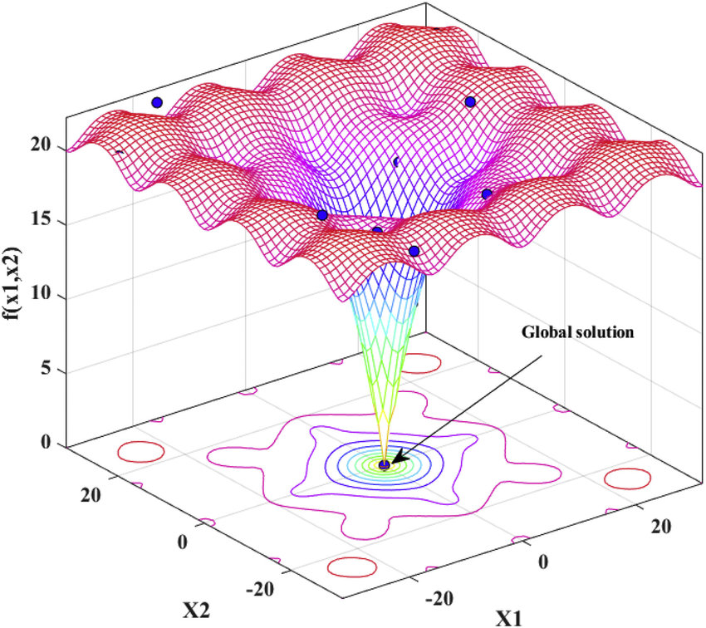

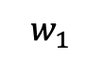
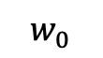
Loss Functions, Cost Functions
$$J(w)$$
$$w_{0}$$
$$w_{1}$$
Notes:
Guidelines
Use a title slide at the beginning of your presentation. There are 9 variations of title slides to choose from.
If you will have a series of slideshows, we recommend using the same style of title slide for each presentation.
Keep your title to no more than 2 lines.
Do not change the font style or font size of the title or subtitle.

Slide 3
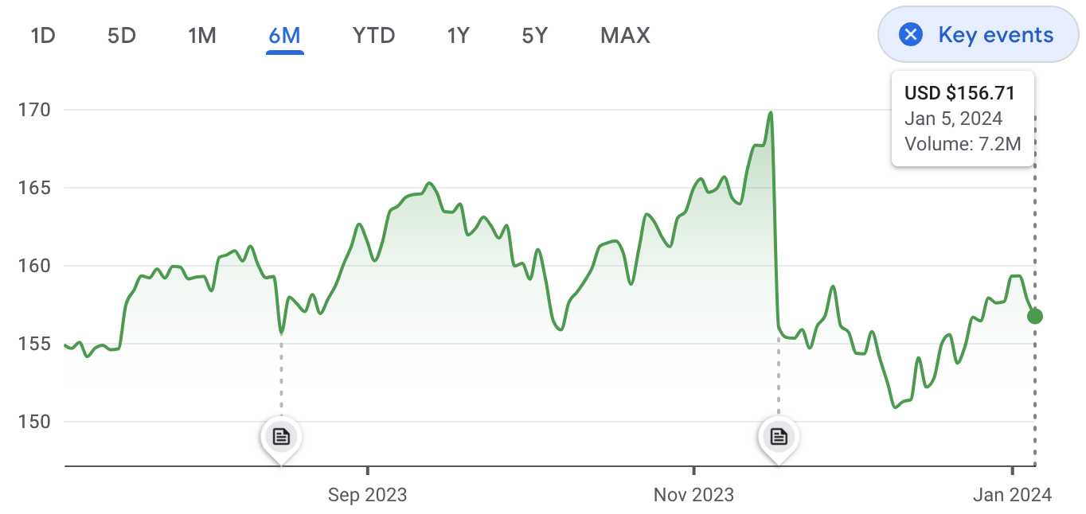
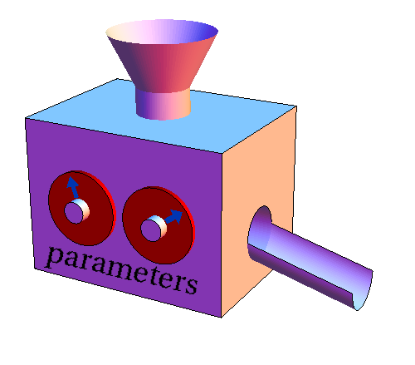
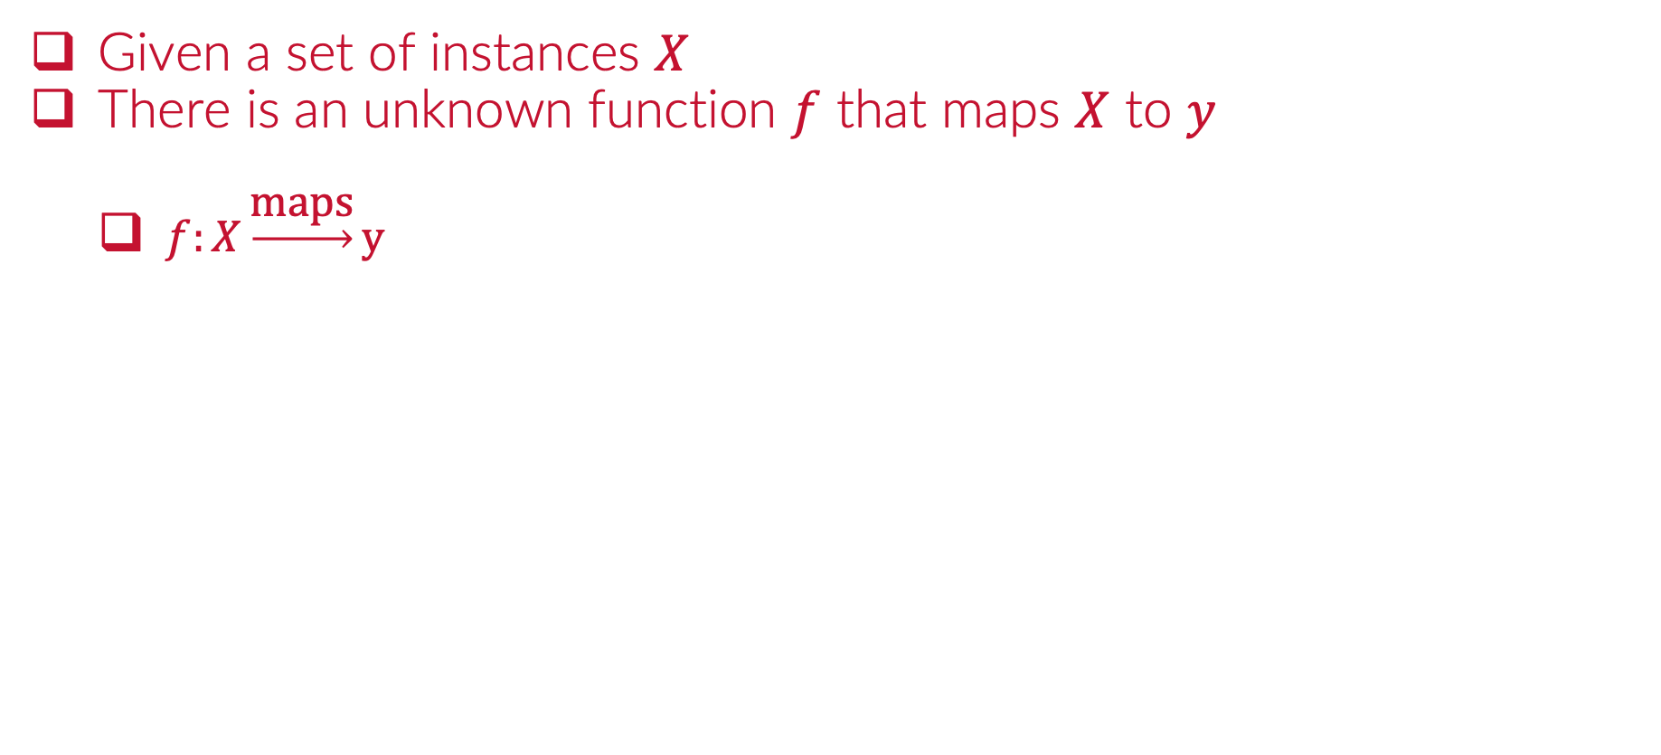
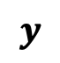

Supervised Learning
Given a set of instances $X$
There is an unknown function $f$ that maps $X$ to $y$
$f:X\underset{→}{\text{maps}}y$
$$X$$
$$y$$

Slide 4
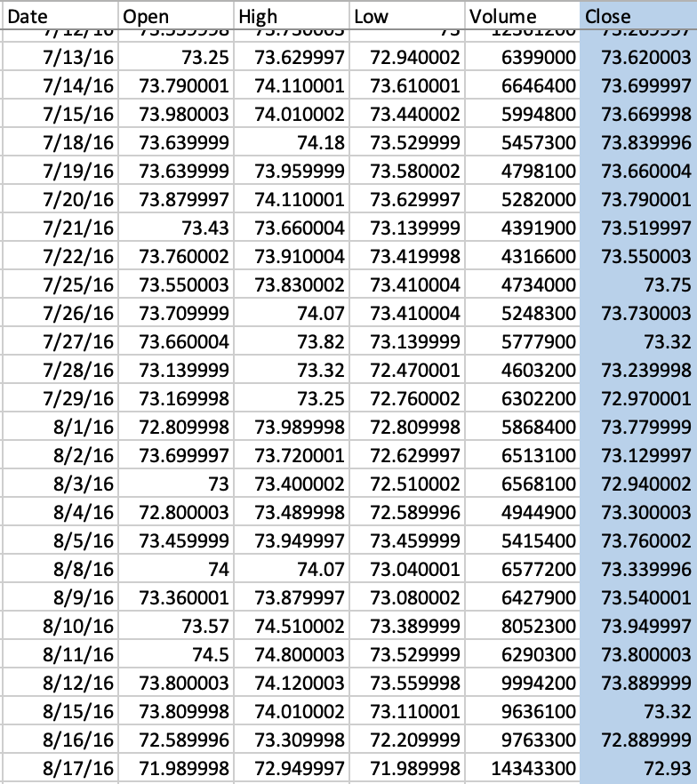




Supervised Learning
Given a set of instances $X$
There is an unknown function $f$ that maps $X$ to $y$
$f:X\underset{→}{\text{maps}}y$
$h:X\underset{→}{\text{maps}}y$
$$X$$
$$h_{w}$$
$$w$$
$$y$$

Slide 5
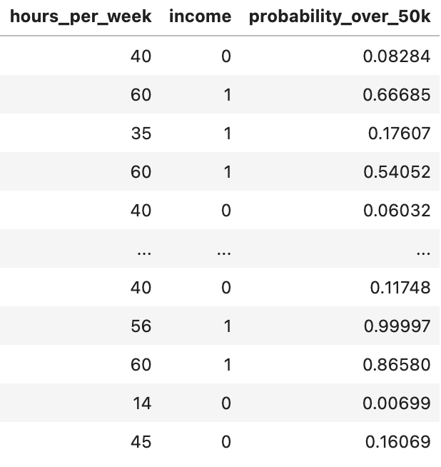
Supervised Learning
Given a set of instances $X$
There is an unknown function $f$ that maps $X$ to $y$
$f:X\underset{→}{\text{maps}}y$
$h:X\underset{→}{\text{maps}}y$
$$X$$
$$h_{w}$$
$$w$$
$$y$$

Slide 6
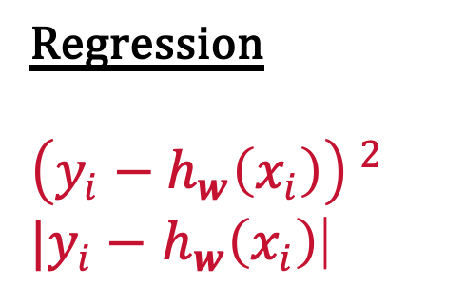
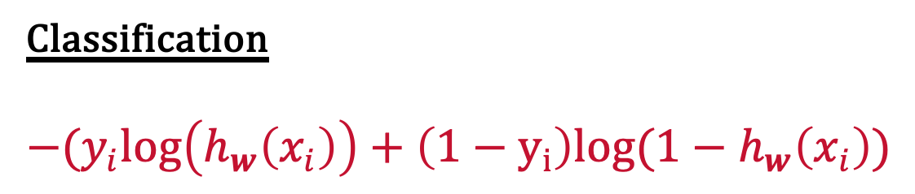
What is a Loss Function?
Is the function that computes the distance between the current output of the algorithm and the expected output.
Calculates the error of the hypothesis.
Generally referred to an instance for a single training sample.
Regression
$$\left(y_{i}−h_{w}\left(x_{i}\right)\right) ^{2}$$
$|y_{i}−$ $h_{w}\left(x_{i}\right)$|
Classification
$$−(y_{i}log\left(h_{w}\left(x_{i}\right)\right)+\left(1−y_{i}\right)log(1−h_{w}\left(x_{i}\right))$$

Slide 7
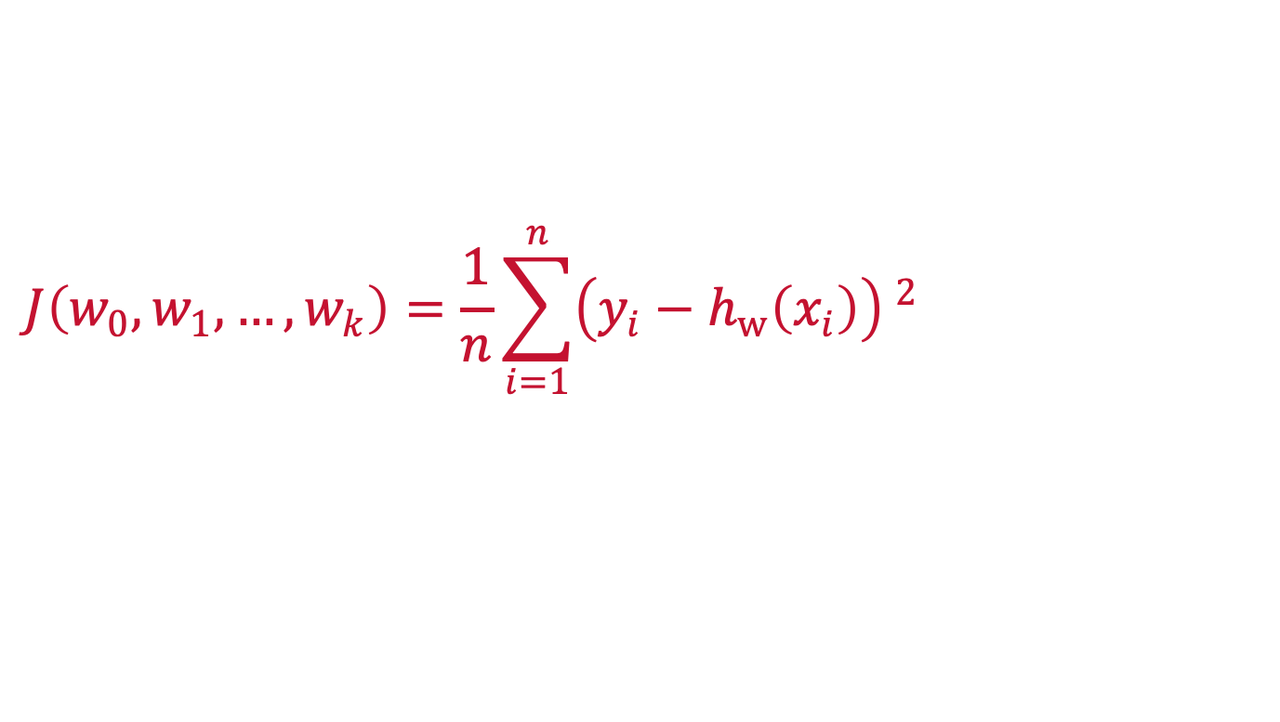

What is a Cost Function?
Is the sum (or average) of the loss function over all observations in the training set.
$$J\left(w_{0},w_{1},…, w_{k}\right)=\frac{1}{n}\sum_{i=1}^{n}{\left(y_{i}−h_{w}\left(x_{i}\right)\right) ^{2}}$$
$$J\left(w\right)={\frac{1}{n}\left\|y−h_{w}\left(X\right)\right\|}_{2}^{2}$$

Slide 8

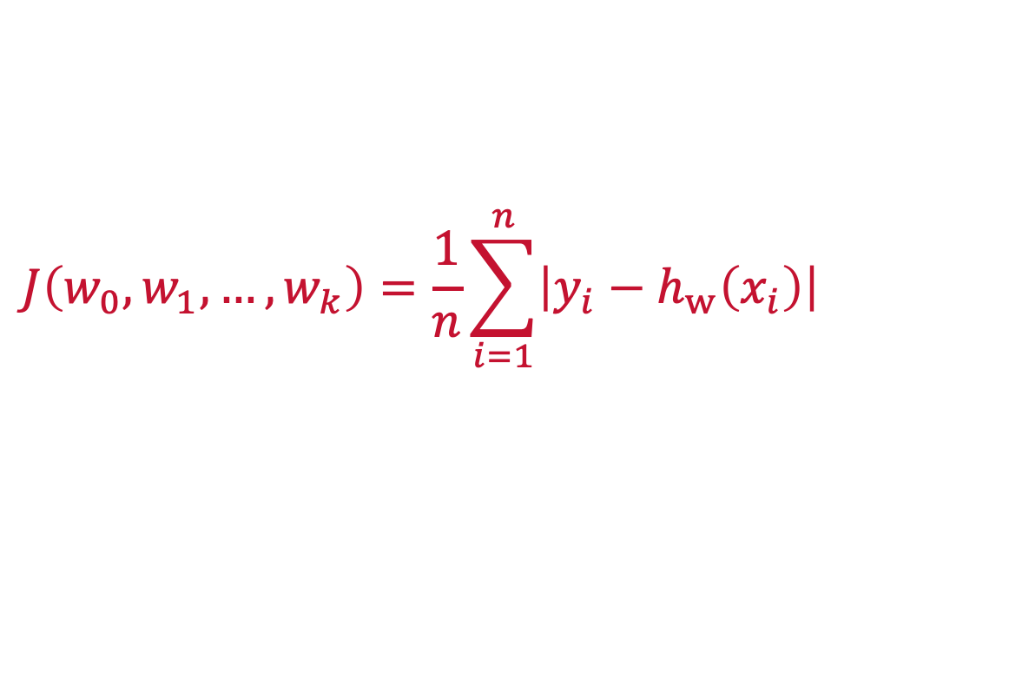
What is a Cost Function?
Is the sum (or average) of the loss function over all observations in the training set.
$$J\left(w_{0},w_{1},…, w_{k}\right)=\frac{1}{n}\sum_{i=1}^{n}{\left|y_{i}−h_{w}\left(x_{i}\right)\right|}$$
$$J\left(w\right)$$

Slide 9
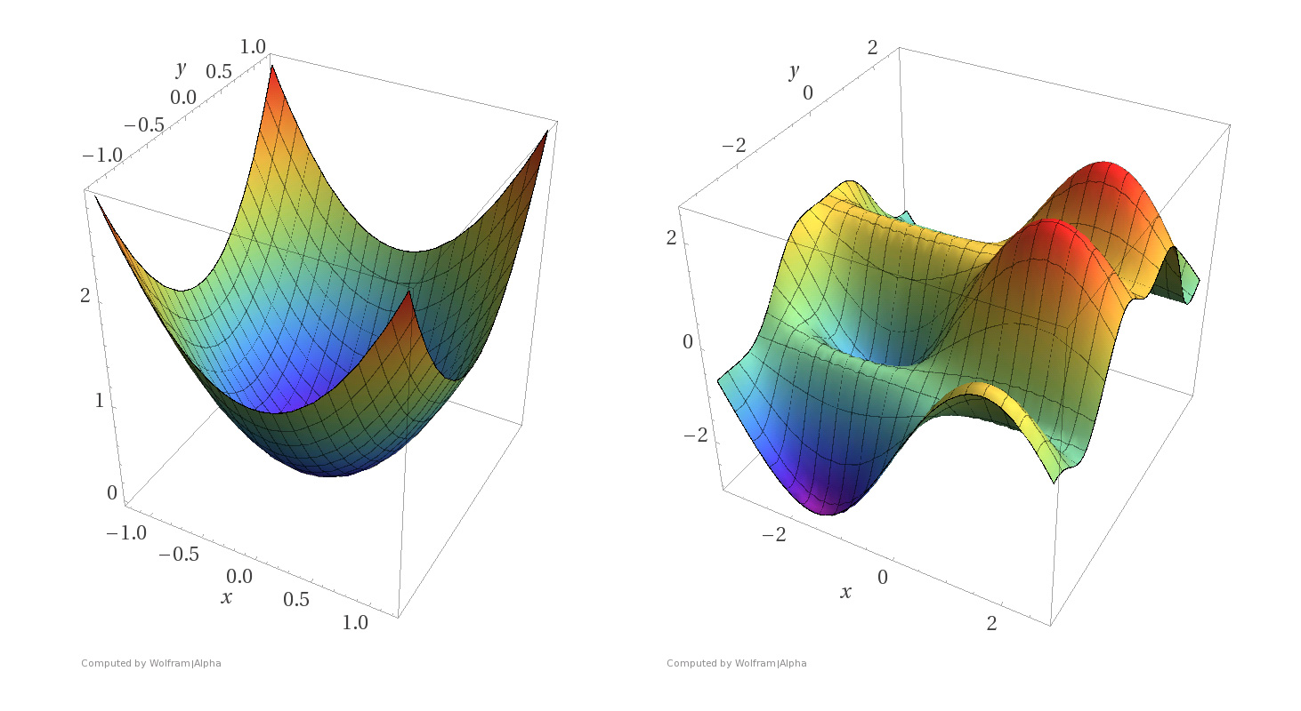






Convex Cost Functions
Convex functions have a unique global minimum and no local minima, making it easier to solve with a simpler optimization algorithm.
convex
non-convex
$$J(w)$$
$$J(w)$$
$$w_{1}$$
$$w_{1}$$
$$w_{0}$$
$$w_{0}$$

Slide 10
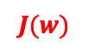

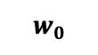


Convex Cost Functions
Non-convex cost function have both local and global minima
Non-convex cost functions require an advanced optimization algorithm to find the global minimum.
convex
non-convex
$$J(w)$$
$$J(w)$$
$$w_{1}$$
$$w_{1}$$
$$w_{0}$$
$$w_{0}$$

Slide 11
Convex Cost Functions
Non-convex cost function have both local and global minima
Non-convex cost functions require an advanced optimization algorithm to find the global minimum.
$$J(w)$$
$$w_{0}$$
$$w_{1}$$

Slide 12
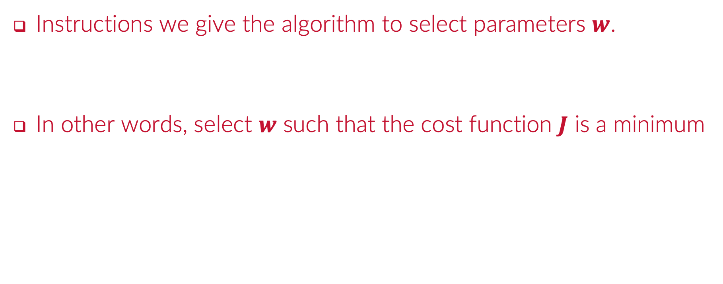

What is an Objective Function?
Instructions we give the algorithm to select parameters $w$.
In other words, select $w$ such that the cost function $J$ is a minimum
$$\min_{w}{J(w)}$$
$$J(w)$$
$$w_{0}$$
$$w_{1}$$

Slide 13

What is an Objective Function?
Optimizers allow us to fine-tune parameters during training.
$$\min_{w}{J(w)}$$

Slide 14


What is the most common notation for the COST function for an algorithm?
ⓘ Start presenting to display the poll results on this slide.

Slide 15
In linear regression the residuals sum of squares (RSS) is the
ⓘ Start presenting to display the poll results on this slide.

Slide 16
Which of the following best describes a loss function in machine learning?
ⓘ Start presenting to display the poll results on this slide.

Slide 17
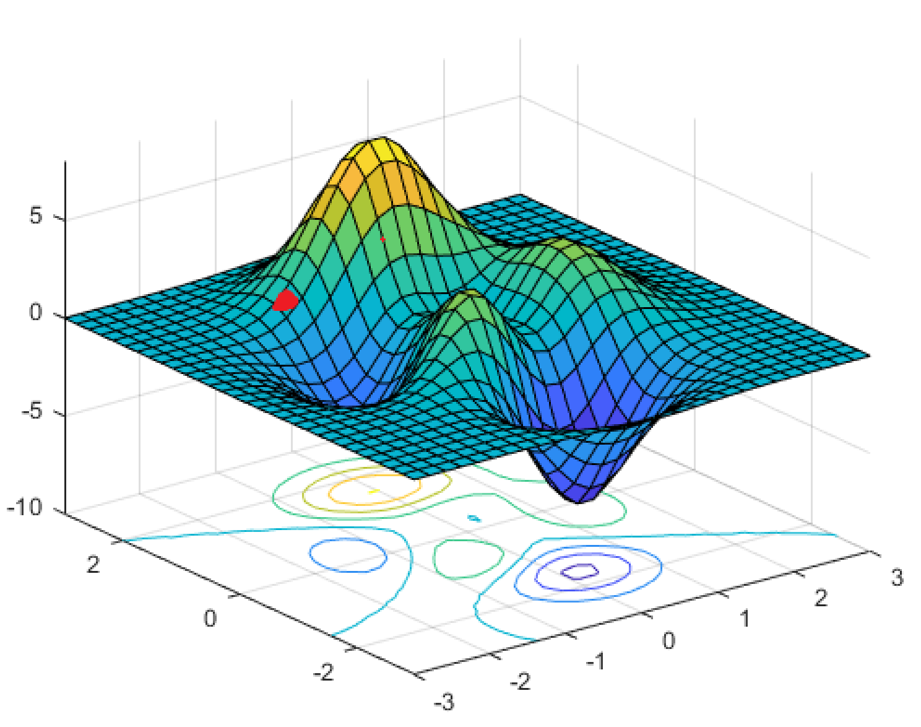
Gradients
Notes:
Guidelines
Use a title slide at the beginning of your presentation. There are 9 variations of title slides to choose from.
If you will have a series of slideshows, we recommend using the same style of title slide for each presentation.
Keep your title to no more than 2 lines.
Do not change the font style or font size of the title or subtitle.

Slide 18
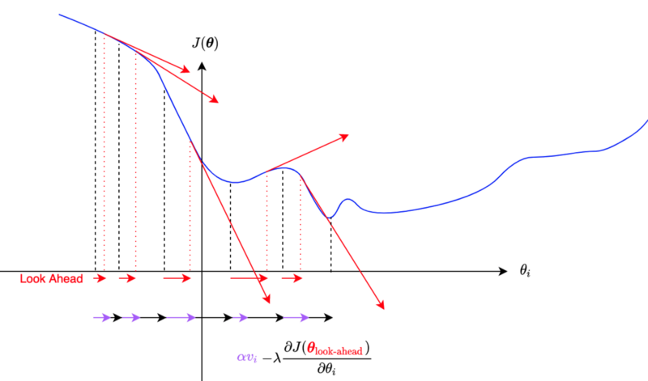
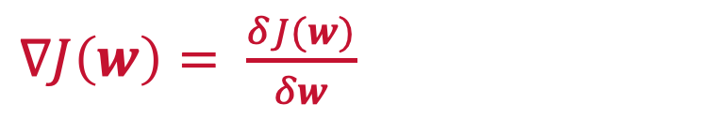
What is the Gradient to a Cost Function?
The gradient to a cost function refers to the instantaneous rate of change (descent).
Mathematically, it is derivative of the cost function with respect to the estimated parameters
$∇J\left(w\right)= \frac{δJ(w)}{δw}$

Slide 19
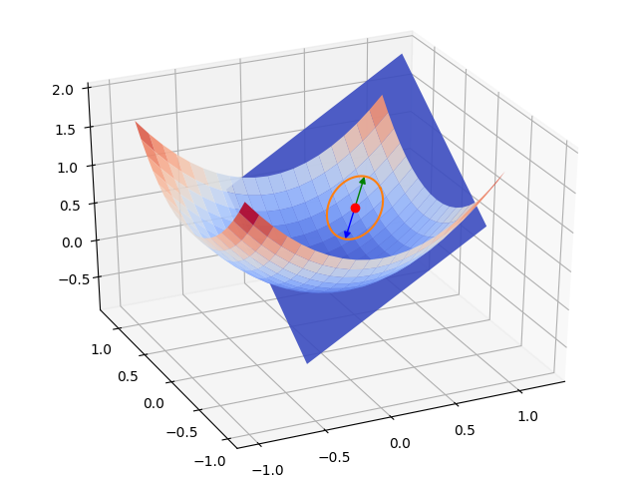
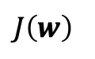
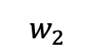
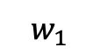
What is the Gradient to a Cost Function?
The gradient to a cost function refers to the instantaneous rate of change (descent).
Mathematically, it is derivative of the cost function with respect to the estimated parameters
$$J\left(w\right)$$
$∇J\left(w\right)= \frac{δJ(w)}{δw}$
$$w_{2}$$
$$w_{1}$$

Slide 20
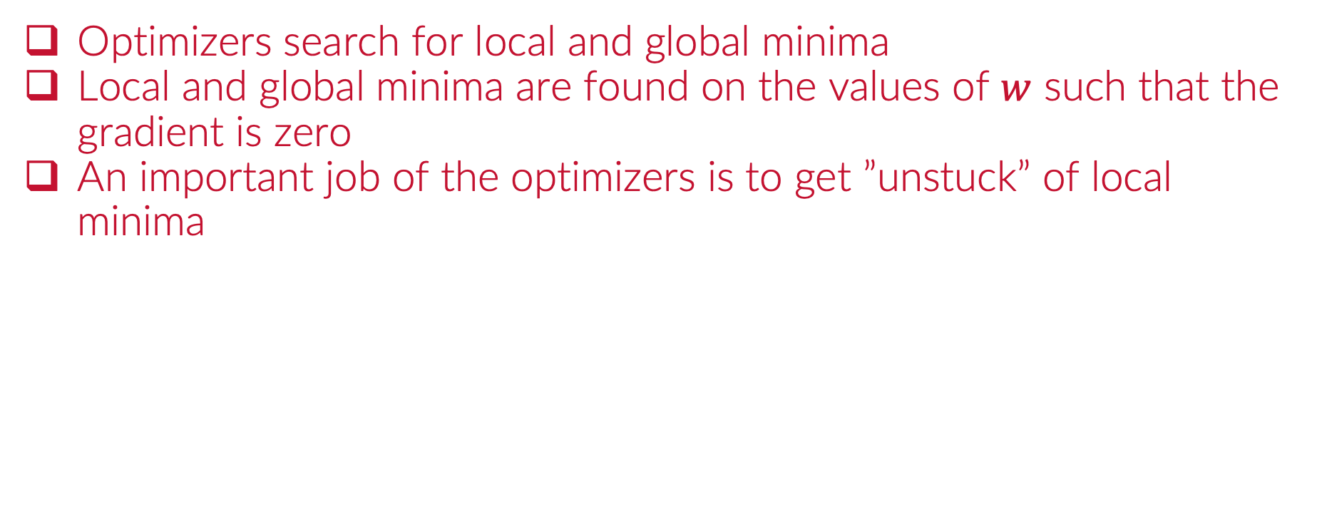
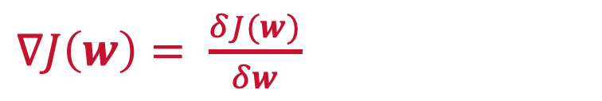
What is the Gradient to a Cost Function?
Optimizers search for local and global minima
Local and global minima are found on the values of $w$ such that the gradient is zero
An important job of the optimizers is to get ”unstuck” of local minima
$∇J\left(w\right)= \frac{δJ(w)}{δw}$
$$J(w)$$
$$w_{0}$$
$$w_{1}$$

Slide 21
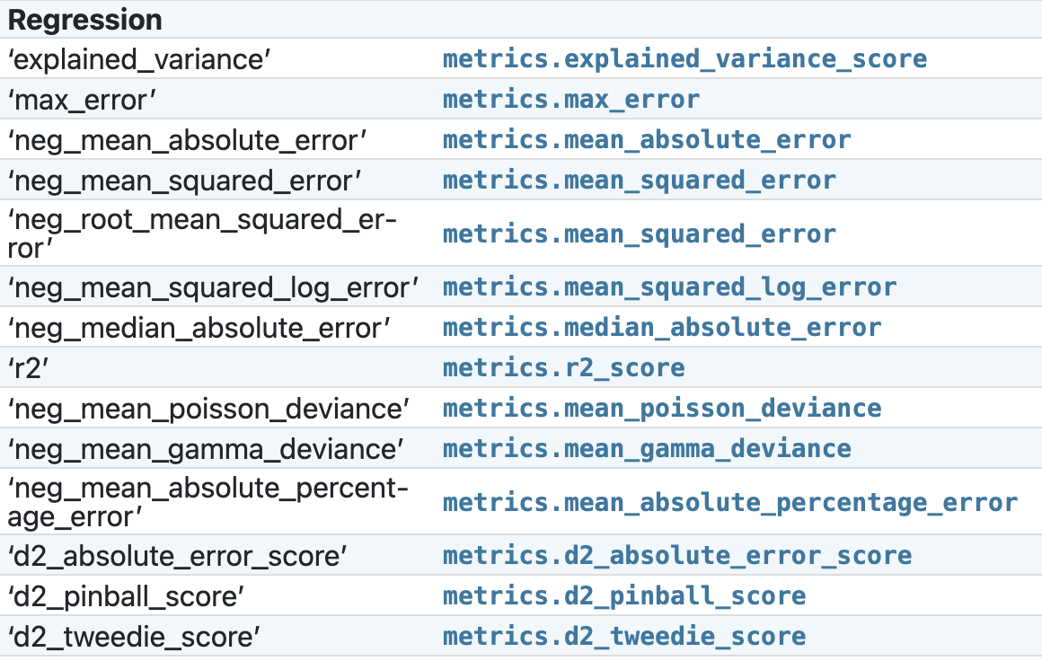
Metrics vs Cost Functions
Metrics are used to check the progress of the ML algorithm.
Cost functions are used in the inner workings of the algorithm to update w and may NOT be known by practitioner.

Slide 22
The derivative of the cost function with respect to the estimated parameters is called:
ⓘ Start presenting to display the poll results on this slide.

Slide 23
A minimum of the cost function occurs when the gradient is equal to zero.
ⓘ Start presenting to display the poll results on this slide.

Slide 24
Local and global minima of a cost function are found on the values of w such that the gradient J(w) is zero
ⓘ Start presenting to display the poll results on this slide.

Slide 25
An important job of the optimizers is to get ”unstuck” of the global minimum
ⓘ Start presenting to display the poll results on this slide.

Slide 26
Metrics are the functions used to update the parameters w.
ⓘ Start presenting to display the poll results on this slide.

Slide 27
Python
Notes:
Guidelines
Use a title slide at the beginning of your presentation. There are 9 variations of title slides to choose from.
If you will have a series of slideshows, we recommend using the same style of title slide for each presentation.
Keep your title to no more than 2 lines.
Do not change the font style or font size of the title or subtitle.

